Slide 1

Act Locally, Impact Globally

Slide 2
Lecture 8: Performance Metrics for Machine Learning

Slide 3
Objectives
To understand:
Use of different model evaluation metric for classification problems
Use of different model evaluation metric for Regression Problems

Slide 4
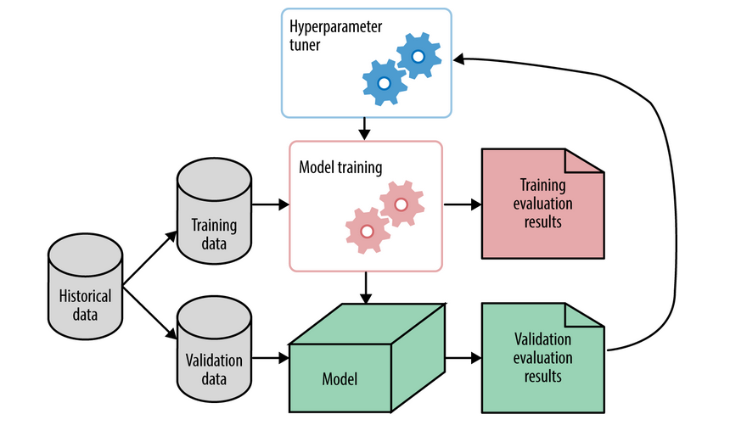
Why evaluation is needed?

Slide 5
Why Evaluation is needed?
To check how well the model is performing ?
Training Performance ( How well it learns the training data)
Performance on Test Data ( How well it works on unseen data with known labels)
Performance in Production ( How well it behaves in real world )

Slide 6
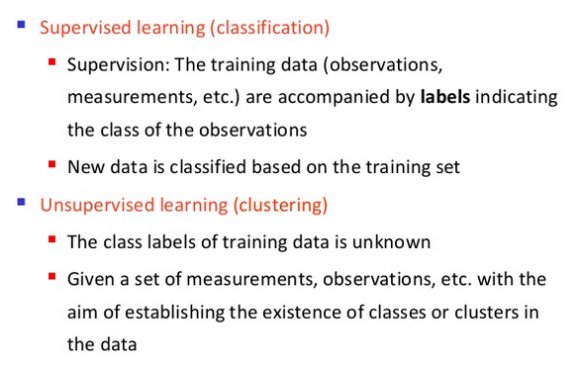
Learning Types

Slide 7
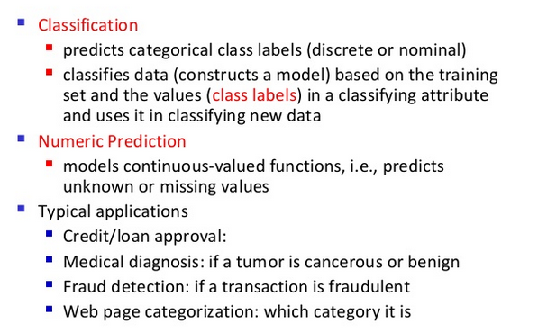
Supervised Learning

Slide 8
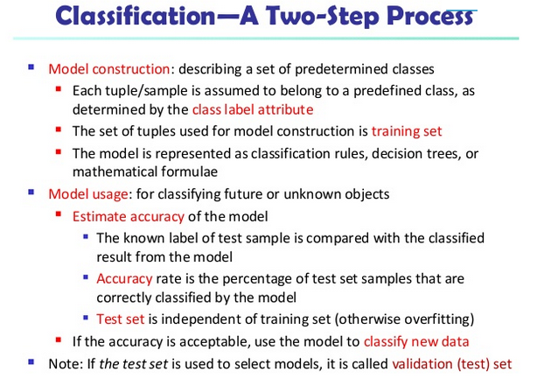
Classification

Slide 9
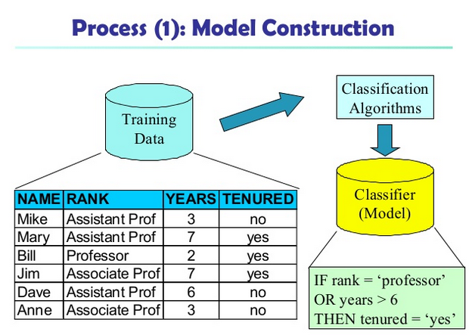
Classification

Slide 10
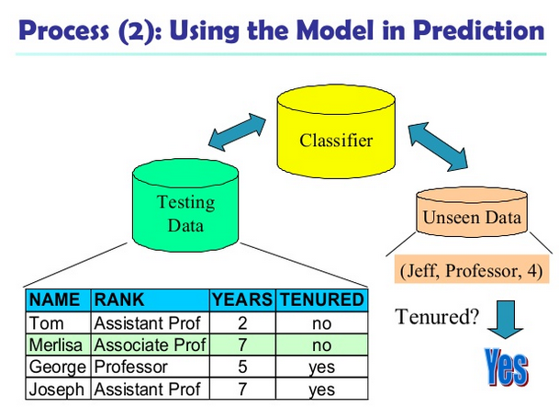
Classification

Slide 11
Evaluation Metric for Classification Tasks
There are several measure to Evaluate a classifier including:
Accuracy / Recognition Rate
Error Rate / Misclassification Rate
Precision
Recall ( Sensitivity , TPR)
Specificity ( TNR)
F-Measure / F-Score

Slide 12
CONFUSION MATRIX
In the field of machine learning a confusion matrix:
is a specific table layout that allows visualization of the performance of an algorithm, typically a supervised learning one
Each row of the matrix represents the instances in a predicted class
While each column represents the instances in an actual class (or vice versa).
The name stems from the fact that it makes it easy to see if the system is confusing two classes (i.e. commonly mislabeling one as another).
It is a special kind of contingency table, with two dimensions ("actual" and "predicted"), and identical sets of "classes" in both dimensions
Source: Wikipedia

Slide 13
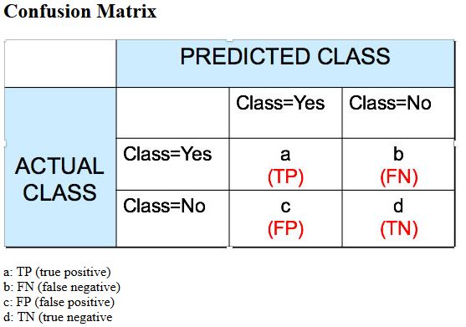
CONFUSION MATRIX

Slide 14
Confusion Matrix - Terminologies Matrix
True Positive (TP): These refer to the positive tuples that were correctly labeled by the classifier.
True Negative (TN): These are the negative tuples that were correctly labeled by the classifier.
False Positive (FP): These are the negative tuples which are incorrectly labeled as Positive
False Negative (FN): These are the positive tuples incorrectly labeled as Negative.

Slide 15
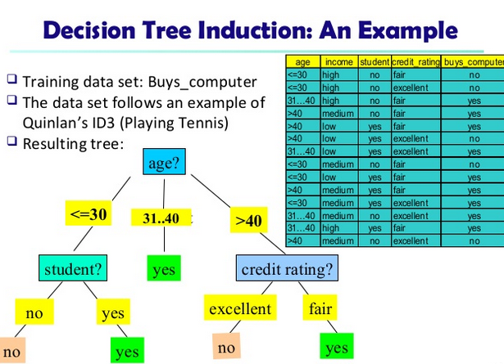
An Example

Slide 16
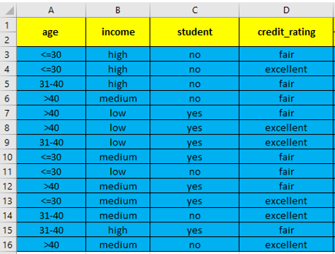
Test Dataset

Slide 17
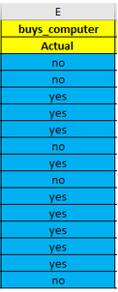
Test Dataset
Class Labels

Slide 18
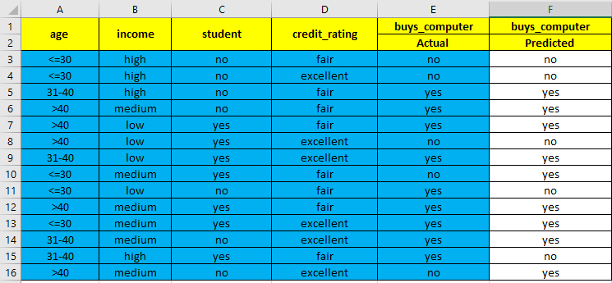
Prediction on Test Dataset

Slide 19
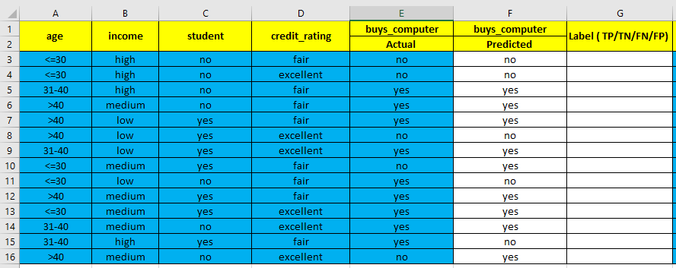
Making a Confusion Matrix

Slide 20
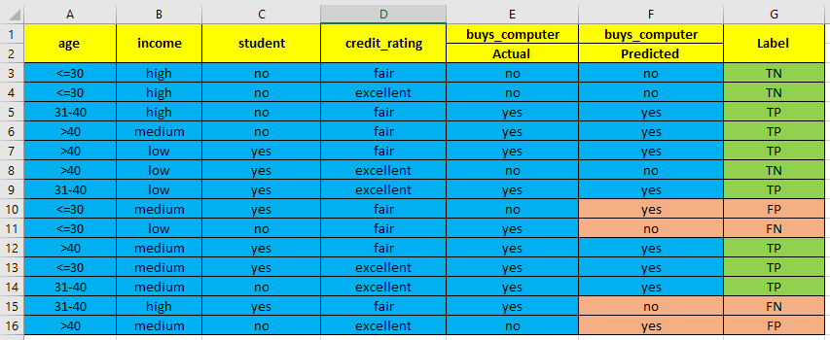
Making a Confusion Matrix

Slide 21
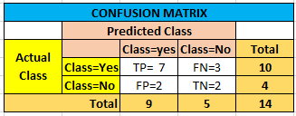
Making a Confusion Matrix

Slide 22

Evaluation Metrics
Accuracy / Recognition Rate
Accuracy of a classifier on a given test set is the percentage of test set tuples that are correctly classified by the classifier.

Slide 23
Evaluation Metrics
Error Rate / Misclassification Rate
It is the percentage of tuples that have been classified incorrectly
Error Rate = 1- Accuracy
Error Rate = ( FP +FN)/ ( TP+TN+FN+FP)
TP+ FN=P
TN+FP=N
Error Rate = ( FP +FN)/ ( P+N)
TP+TN+FP+FN=P+N=Total Number of Tuples / Instances / Rows

Slide 24
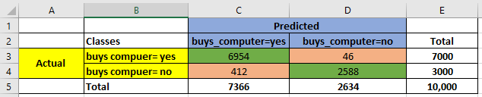
Compute Accuracy & Error Rate

Slide 25
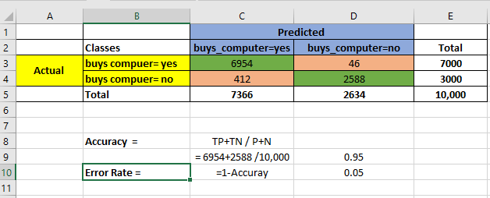
Compute Accuracy & Error Rate

Slide 26
Accuracy can be Misleading
Class Imbalance Problem
Where the main class of interest is rare
Fraud Detection Application
Main class of interest is “ fraud= yes”
Main class “ fraud=yes” occurs much less frequently as compared to “fraud=no”
Medical Data
The outcome of a medical test
Main class of interest : “cancer = yes” or test outcome as positive
An Accuracy rate of 97% may be unacceptable in this case

Slide 27
Accuracy can be Misleading
Cancer Example
Suppose there are 10,000 test/training tuples
9700 tuples have “ cancer = No”
300 are tuples have “cancer=yes”
The classifier is meant to diagnose cancer
The Classifier is 97% accurate
It may be the case ( at worst) that it is accurately predicting all 9700( 97%) tuples and committing mistakes on all tuples where “cancer=yes”
Do you think this 97% accurate classifier is acceptable in this case?

Slide 28
Class Imbalance Problem
In case of class imbalance problem , we should use the following evaluation metrics:
Sensitivity / TPR /Recall
Specificity /TNR

Slide 29

Sensitivity / Recall / TPR
Recall
It is the proportion of the positive tuples that are correctly identified
Also called True Positive Rate

Slide 30

Specificity / TNR
Specificity is also called TNR ( True Negative Rate )
It is the proportion of negative tuples correctly identified by the classifier

Slide 31

Precision
Precision can be thought of as a measure of exactness
It is the percentage of correctly classified positive samples

Slide 32
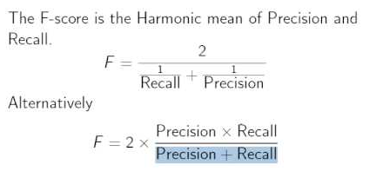
F-Measure
F-Measure combines both Precision and Recall in a single formula

Slide 33
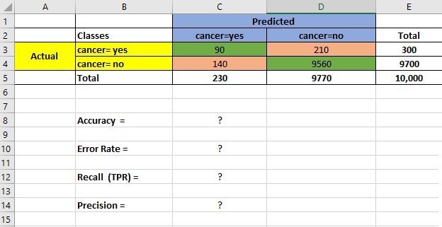
Class Imbalance Example

Slide 34
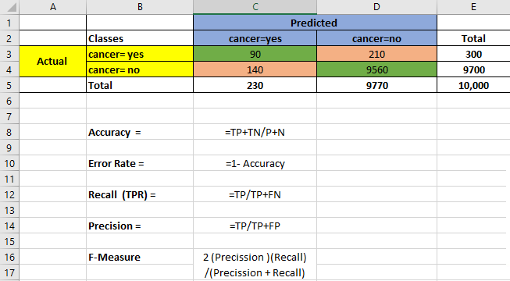
Class Imbalance Example ( Precision & Recall)

Slide 35
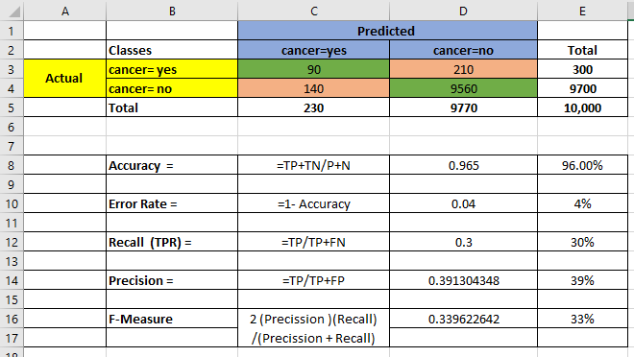
Class Imbalance Example ( Precision & Recall)

Slide 36
Evaluation Metrics - Summary
Different Evaluation metrics include Accuracy , Precision and Recall
When classes are fairly distributed , Accuracy measure works best
When the main class of interest is rare , we call it class imbalance problem
We use Precision , Recall or F-Measure in case of class imbalance problem

Slide 37
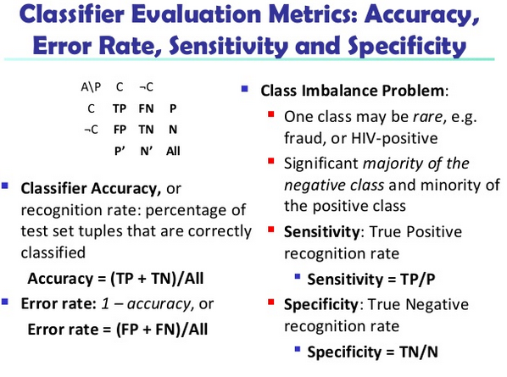
Evaluation Metrics – Summary

Slide 38
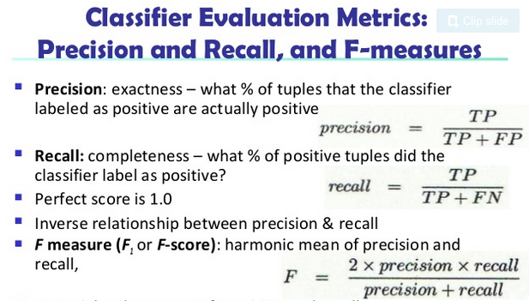
Evaluation Metric – Summary

Slide 39
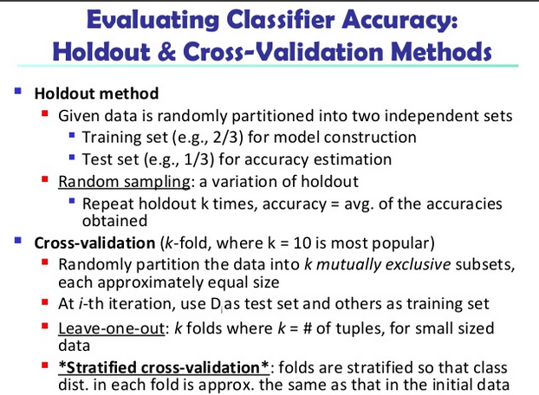
Evaluating Classifier Accuracy

Slide 40
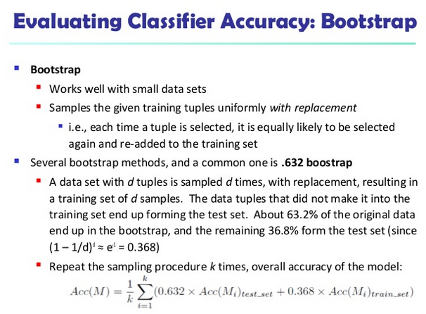
Evaluating Classifier Accuracy

Slide 41
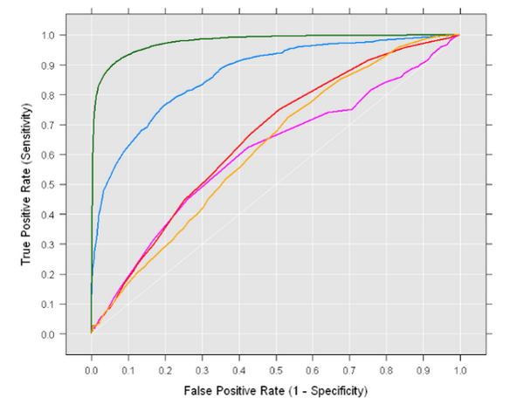
ROC Curve

Slide 42
ROC Curve
Area under the curve (AUC) shows the diagnostic ability of the classifier
An ROC Curve with a Diagonal Line ( at 45 Degree) indicates that classifiers performance and a Random Guess ( Tossing a coin ) are equal
For Baseline performance , ROC curve must be above 45 Degree Diagonal .

Slide 43
Evaluation Regression
In Regression Problems , we are predicting a numerical values
For Examples predicting the daily sales volume of a particular product
The more close the predicted values are to the actual values , less will be the error
The basic evaluation is “ Error” in Prediction
Error is the difference between the actual values and the predicted value
As we have a number of predictions , we should sum-up all the error and take average

Slide 44
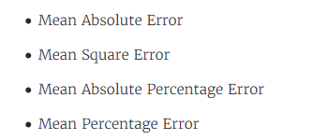
Evaluation Metrics for Regression

Slide 45
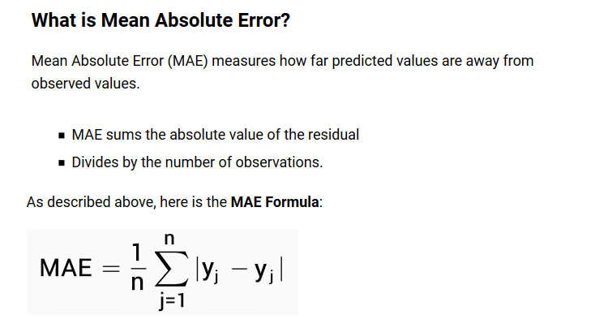
Mean Absolute Error

Slide 46
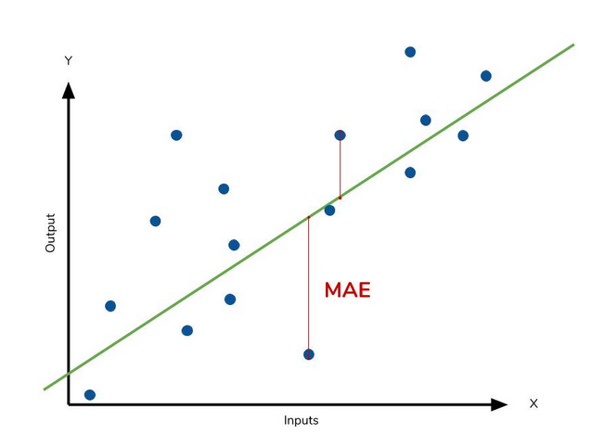
MAE

Slide 47
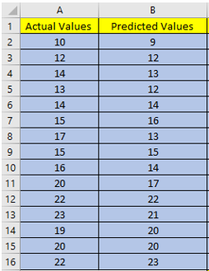
Compute MAE

Slide 48
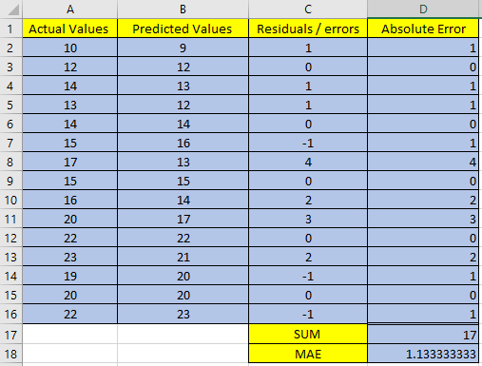

MAE EXAMPLE

Slide 49
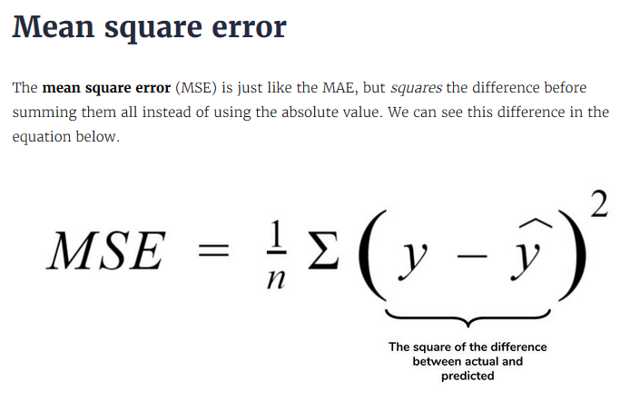
MSE

Slide 50
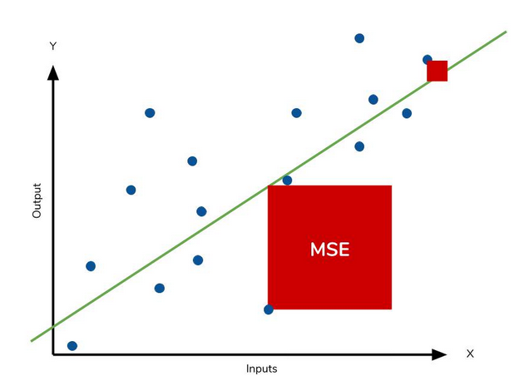
MSE

Slide 51
Compute MSE

Slide 52
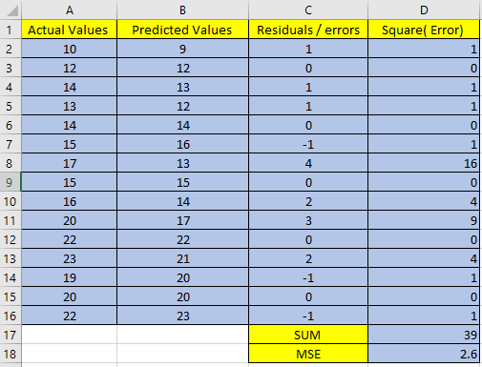
MSE Example

Slide 53
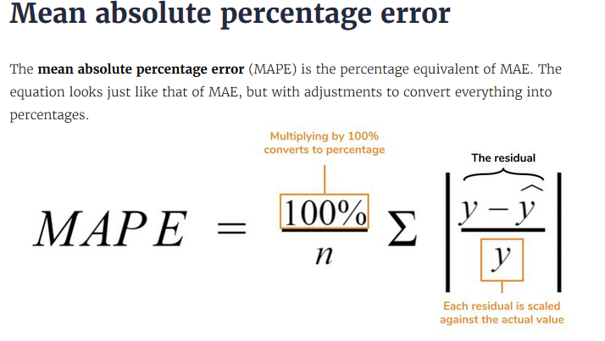
MAPE

Slide 54
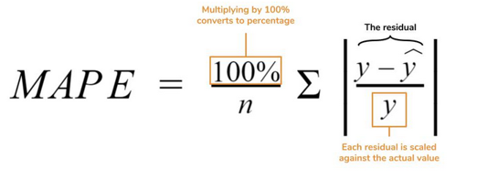
Compute MAPE

Slide 55
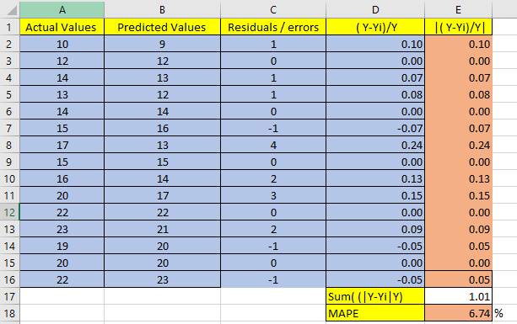
MAPE

Slide 56
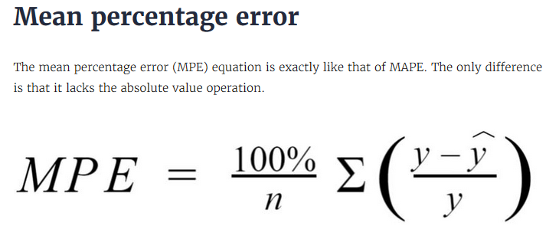
MPE

Slide 57
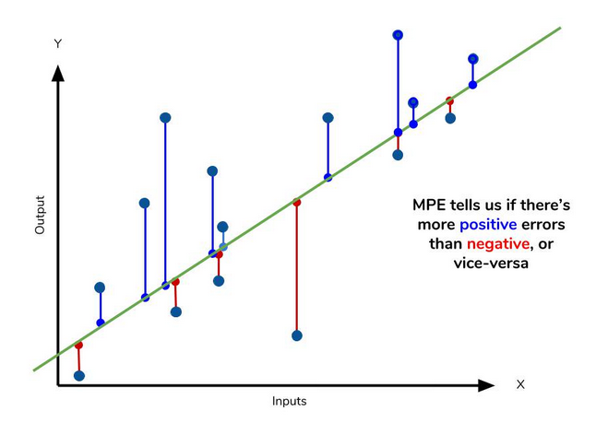
MPE

Slide 58
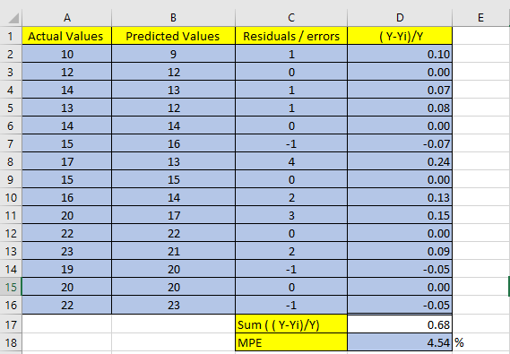
MPE Example

Slide 59
Hands On :

